Slide 1
LLM + PLANNING
Enhancing LLM planning abilities

Slide 2
Plan-Bench – Recap
Setting a benchmark for evaluating intelligence In large language models

Slide 3

Abstract
Evaluating LLM planning abilities
Setting a bench-mark for testing LLM inelegance

Slide 4

Planning
planning involves producing a course of actions (policy) that when executed, would take an agent from a certain initial state to a desired world state
Is part of another branch of AI called reenforced learning – RL
Real world application :
Robots
Automatic Code generation

Slide 5

MDP – Fully observable domains
For a any observable domain, we define:
S - States {s}
A - Actions {a}
Tr – P[s’| a , s] transition matrix
Policy $π(s)$ - given a current state, which action should my agent choose
Examples – blackjack, blocksworld

Slide 6
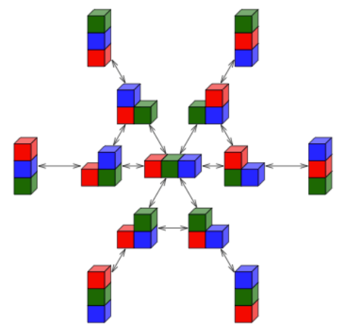
BlocksWorld - Deterministic MDP
Deterministic - Every action on every state has only one outcome
states:
We describe states with Boolean variables -
Clear(Red), In-Hand(Yellow), On(Blue,Green)
We describe the goal state as a conjunction of Boolean variables : { InHand(Red) , On(Yellow,Blue)}

Slide 7
BlocksWorld - deterministic MDP - Actions
We describe actions using :
STACK(X,Y)
PICKUP(X,Y)
PUTDOWN(X,Y)
Each action has pre-conditions and effect
To choose the action – stack(A,B), the preconditions are - clear(B), InHand(A)
The effects will be On(A,B), NOT – clear(B)

Slide 8
BlocksWorld - Example
Init state – On(A,B) , clear(B)
Goal state – On (B,A) , Clear (A)
Plan :
UNSTACK(A,B)
PUT(A)
PICK(B)
STACK(B,A)

Slide 9
Curriculum for Testing
The authors divide the planning capabilities of an LLM model into 8 subcategories:
Plan Generation
Cost Optimal Planning
Plan Verification
Reasoning about plan execution
Robustness to goal reformulation
Ability to reuse plans
Replanning
Plan Generalization

Slide 10
Curriculum for Testing
The categories we focused on are:
Plan Generation - Can the LLM produce valid plans that will achieve a specific goal?
Cost Optimal Planning - Can the LLM produce plans that are optimal to achieve a specific goal?

Slide 11
Dataset size
Total of 600 instances

Slide 12
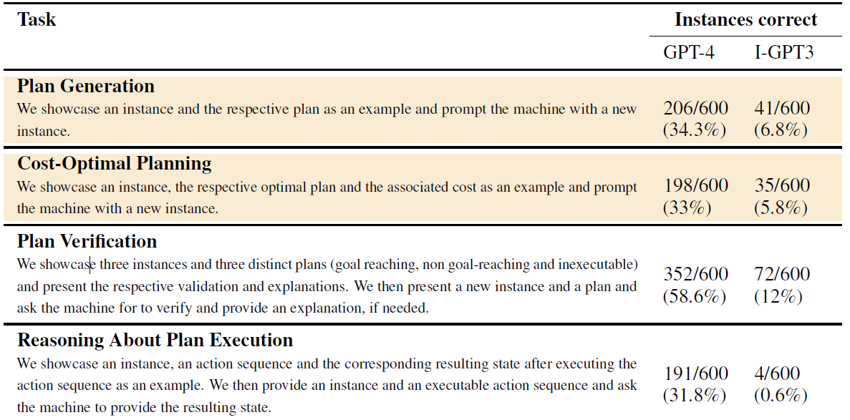
Results

Slide 13
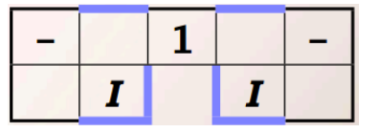
POMDP – Small background
MDP in Partially observable space
After each action, We don’t know new state.
We see an observation that might indicate certain states

Slide 14
LLM + POP
Interactive Planning Using Large Language Models for Partially Observable
by Lingfeng Sun1,2 , Devesh K. Jha2 , Chiori Hori2 , Siddarth Jain2 Radu Corcodel2 , Xinghao Zhu1,2 , Masayoshi Tomizuka1 , Diego Romeres2

Slide 15
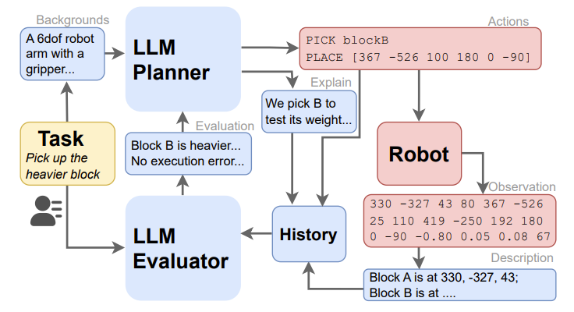
POMDP planner – Architecture

Slide 16
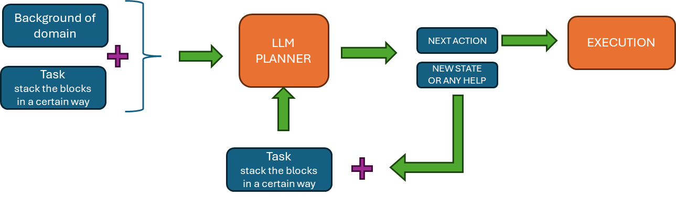
Adjustments for Classical planning
No need for observations, since the actions are deterministic

Slide 17
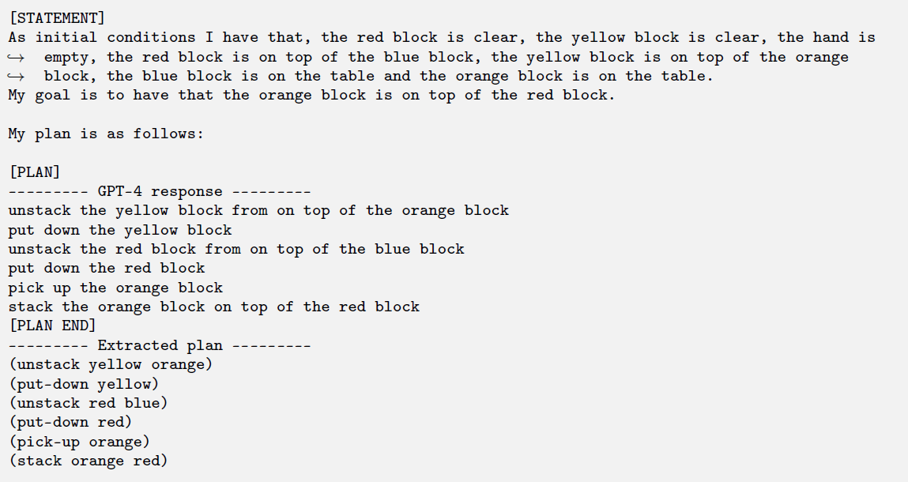
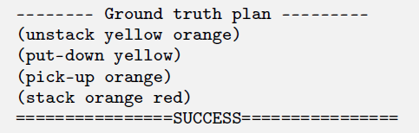
Plan generation test

Slide 18
Additions to prompt
New state – what was the state after the action:
Reasoning – what was the desired state after this action

Slide 19
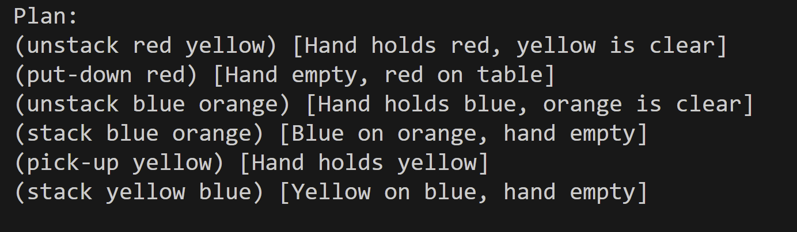
New state – what was the state after the action:

Slide 20
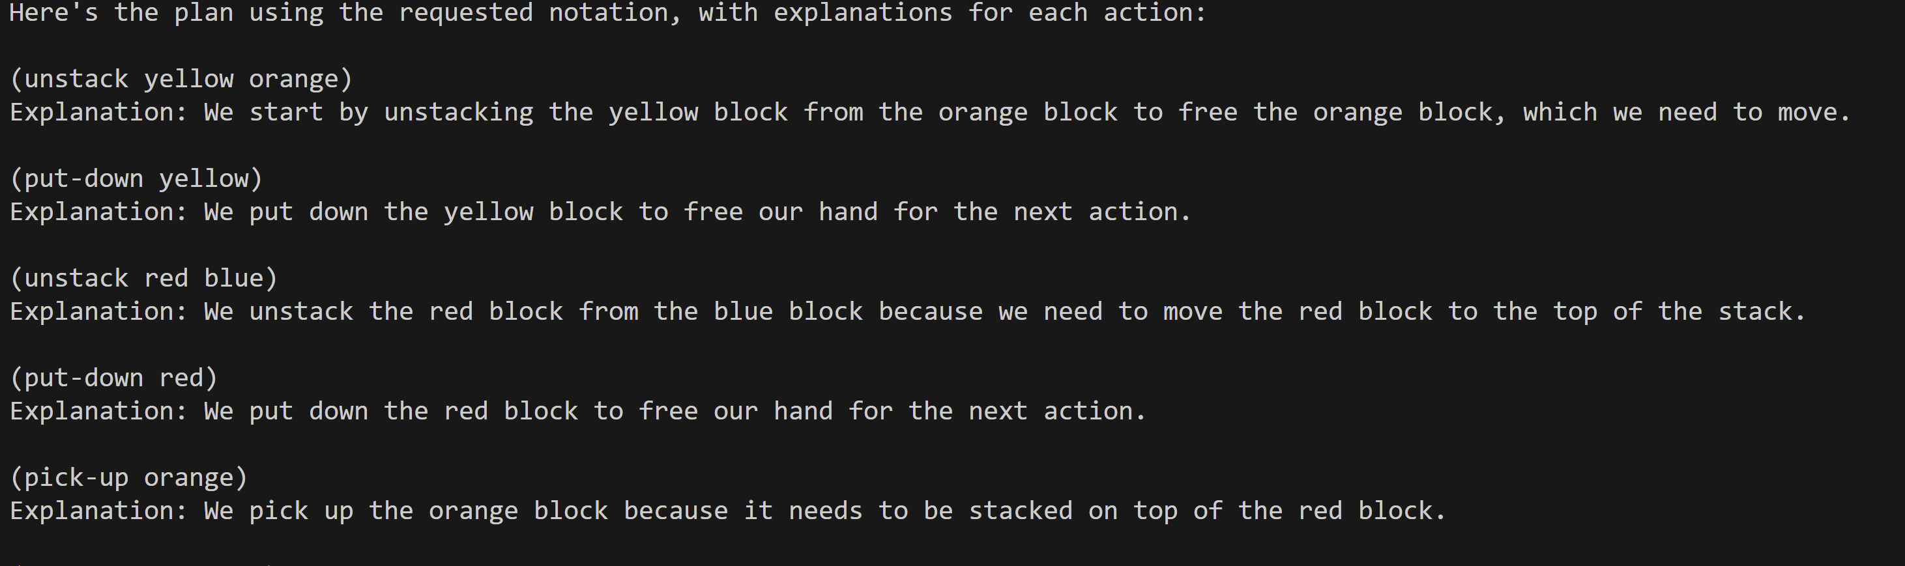
reasoning – whats do we want to achive after the action:

Slide 21
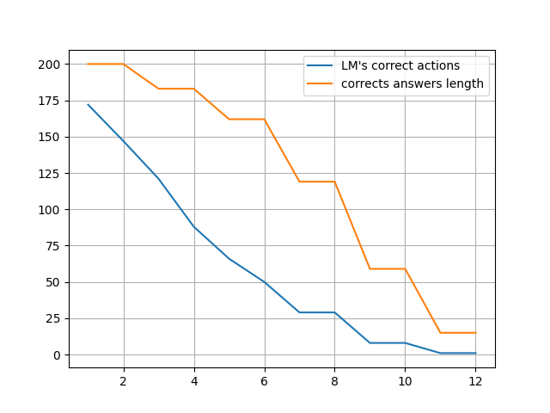
Success rate at different stages
Number of test
Action index

Slide 22
Results – tested on Claude
We ran the tests 5 times on every task ad prompt combo
Success rate Avg.
Cost optimal | Plan generation | Prompt additions
25% | 21% | None
28% | 25% | new state
27% | 20% | Reasoning

Slide 23
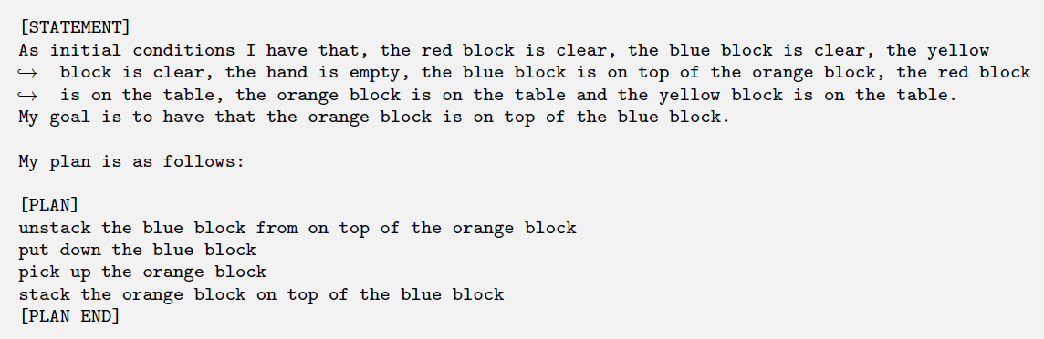
Plan generation test

Slide 24
Plan generation test

Slide 25
Conclusions and further questions
Slight improvement
Check behavior on other LLM models
Try to execute a classical planning algorithm

